Slide 1
HPCAP Computer Networks
Atul Kahate

Slide 2
Sessions 1 and 2

Slide 3
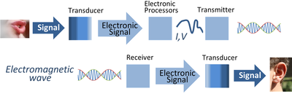
Electronic Communication System

Slide 4
Introduction to Communication System
Communication system allows exchange of data between two stations, transmitter and receiver
Signals pass from source to destination through what is called channel, which represents a way that signal use it to move from source toward destination
To transmit signals in communication system, it must be first processed in several stages, beginning from signal representation, to signal shaping until encoding and modulation
After preparing the transmitted signal, it is passed to the transmission line of channel
Due to the signal crossing this media it faces many impairments such as noise, attenuation and distortion

Slide 5
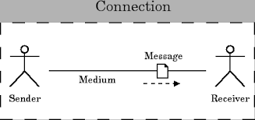
Components of a Data Communication System
Transmission device or Sender
A device that actually sends out the message.(eg computer , telephone, etc).
A medium
A physical channel where the information travels from the sender to the receiver.
Message
The data/information to be transmitted. It can be in the form of text, audio, video, photos, or combination of them.
Receiving device or Receiver
A device that receives the message then process the information in the message.

Slide 6
Issues in Computer Networking
Sharing computer resources
Interaction between computers
Network applications
Physical data transmission
Encoding
Physical link characteristics
Interaction among several computers
Topology
Addressing
Switching

Slide 7
Network Hardware and Software
Two types of transmission technology: Broadcast links and Point-to-point links
Broadcast network
The communication channel is shared by all the machines on the network
Packets sent by any machine are received by all the others.
An address field within each packet specifies the intended recipient.
A wireless network is a common example of a broadcast
Point-to-point network
Links connect individual pairs of machines
Point-to-point transmission with exactly one sender and exactly one receiver is sometimes called unicasting

Slide 8
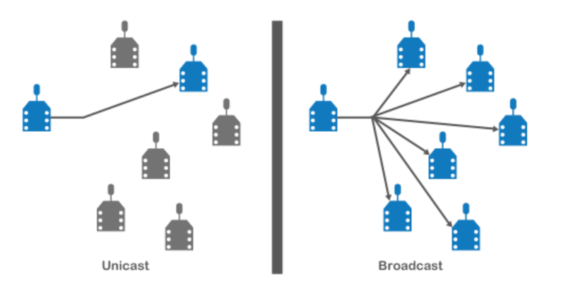
Unicast versus Broadcast

Slide 9
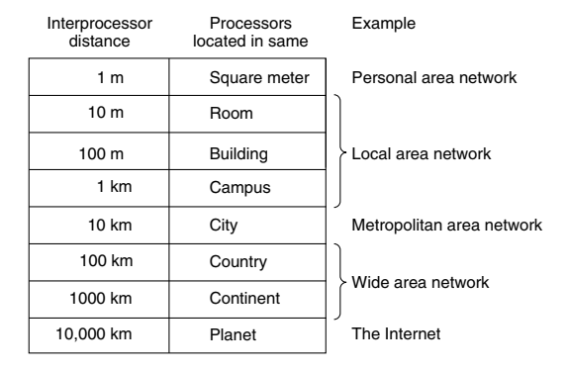
Scale and Network Types

Slide 10
Local Area Network (LAN)
Local Area Network (LAN): A privately owned network that operates within a single building like a home, office or factory
Wireless LANs: In these systems, every computer has a wireless modem and an antenna that it uses to communicate with other computers
An access point or base station controls the network
IEEE 802.11 standard (also called WiFi) describes this

Slide 11
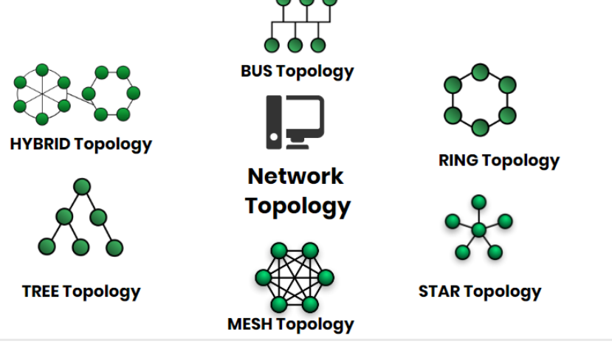
Network Topology
Network Topology represents a network arrangement consisting of several nodes

Slide 12
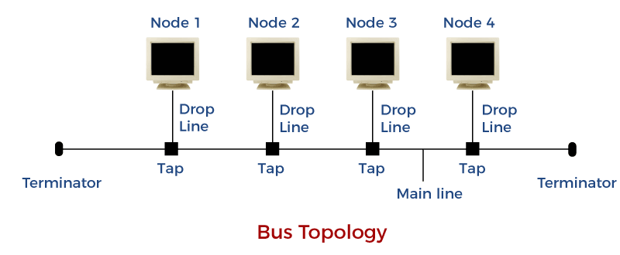
Bus Topology
All the nodes are connected to a common wire, called as bus
Simple and cost-effective, but all depends on a single cable, not fast

Slide 13
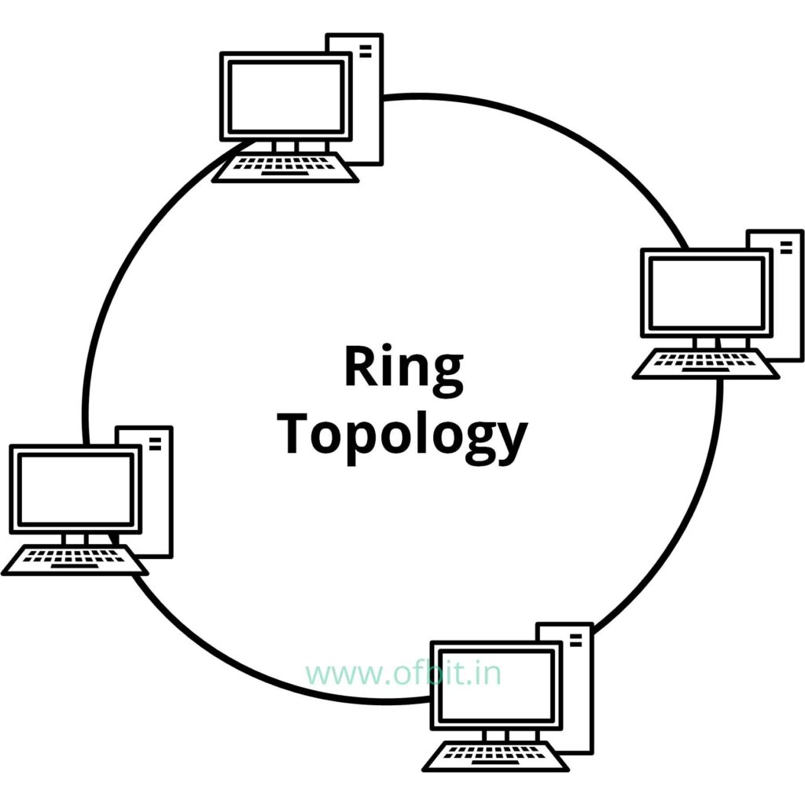
Ring Topology
One computer is connected to the next, and so on, to complete a ring
A transmitting computer needs to have a token, before transmitting
Inexpensive, Tough to add or remove nodes, One node crashing can disconnect the whole network

Slide 14
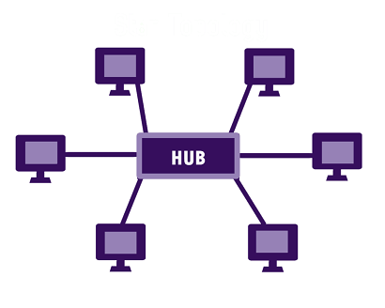
Star Topology
Each device is connected to a central hub
All communication goes through the hub only
Simple, too much of dependence on the hub, but the hub can be upgraded easily, Easy to troubleshoot, Cost is high

Slide 15
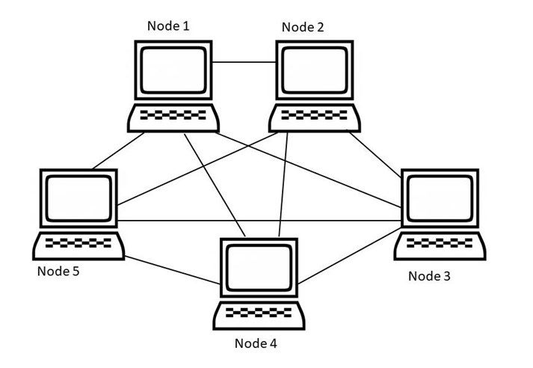
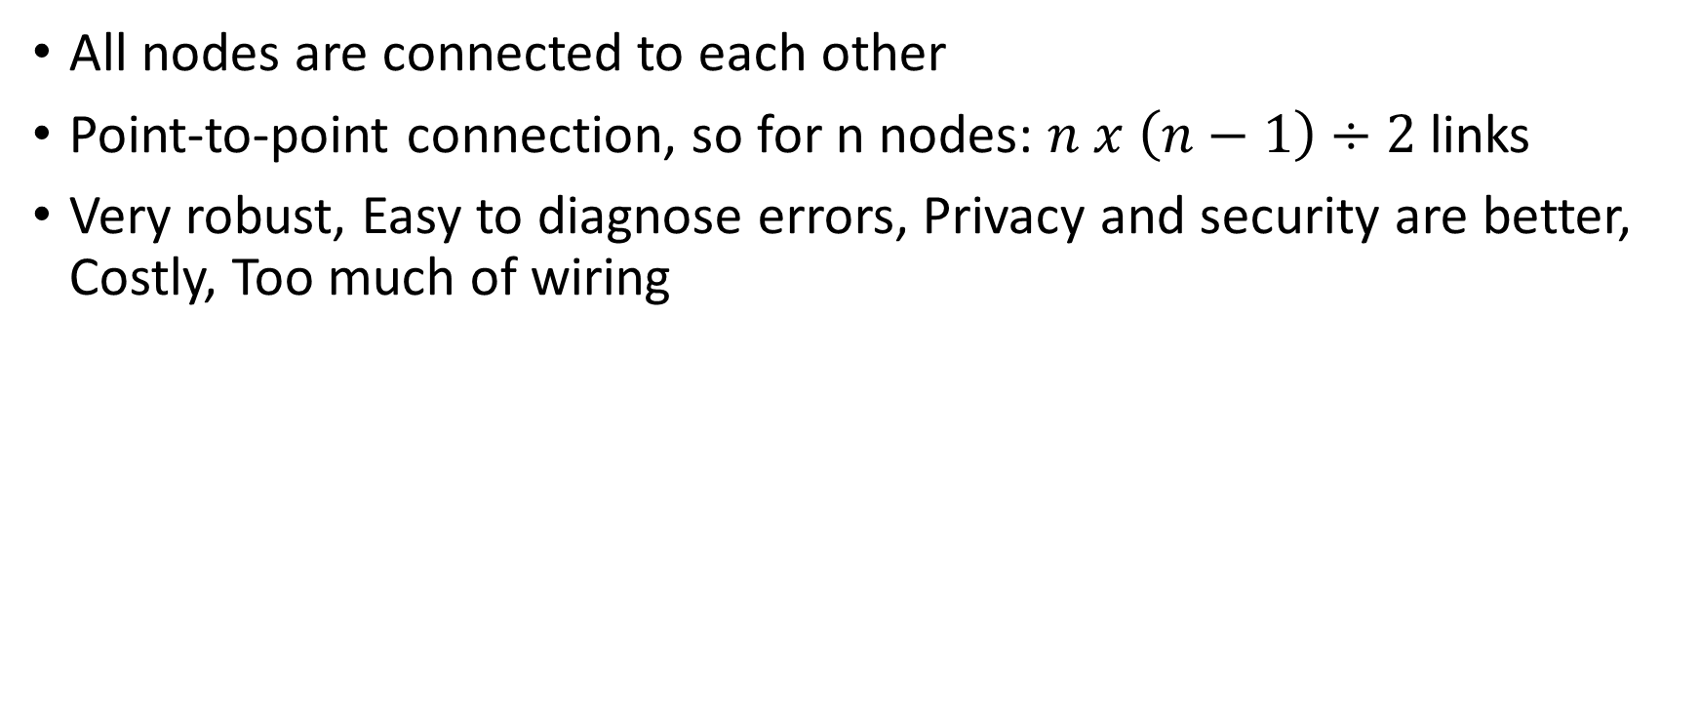
Mesh Topology
All nodes are connected to each other
Point-to-point connection, so for n nodes: $n x \left(n−1\right)÷2$ links
Very robust, Easy to diagnose errors, Privacy and security are better, Costly, Too much of wiring

Slide 16
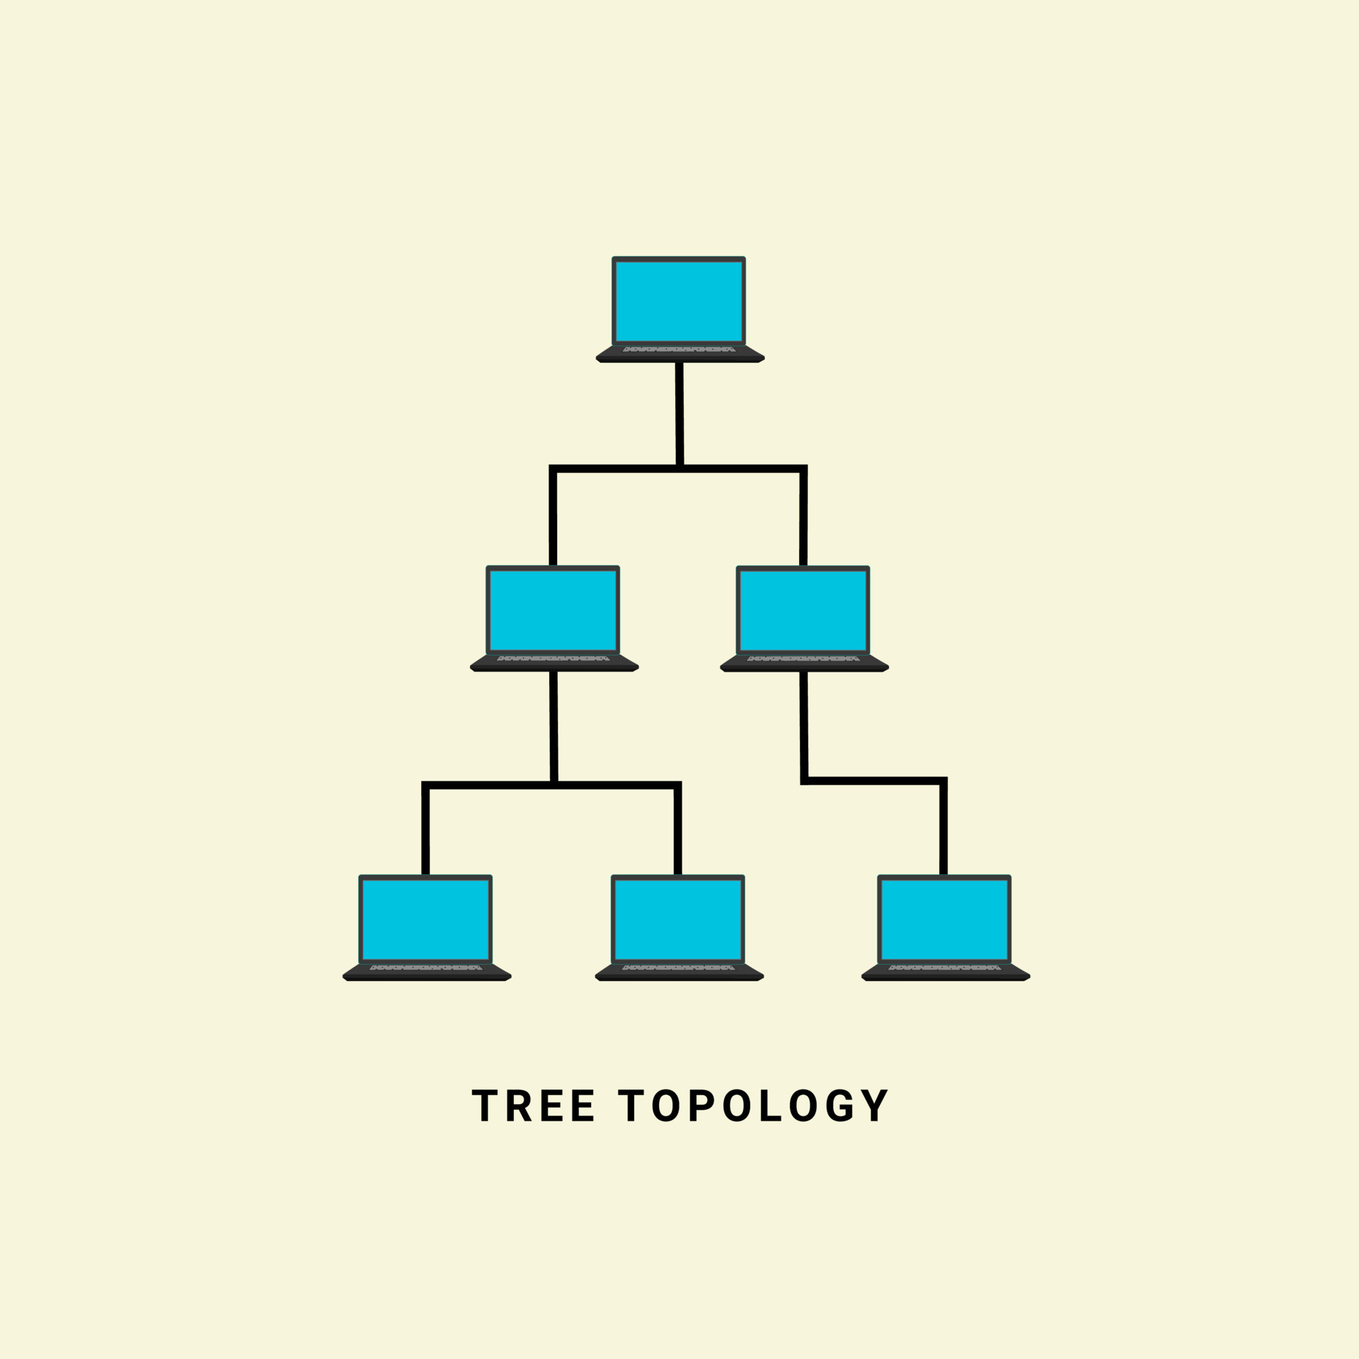
Tree Topology
Nodes are connected hierarchically, ultimately connecting to the top node, called as the root node
Has at least three levels of hierarchy
Easy to expand and manage, debug
Expensive, lot of cabling

Slide 17
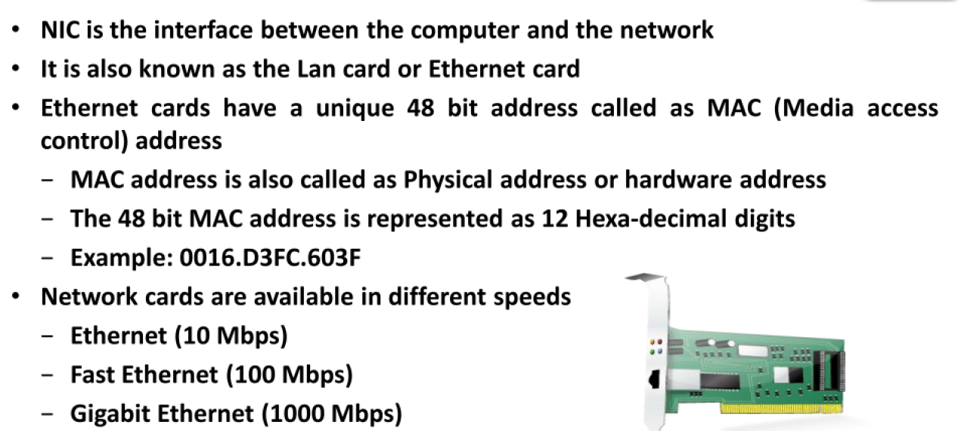
Network Interface Card (NIC)

Slide 18
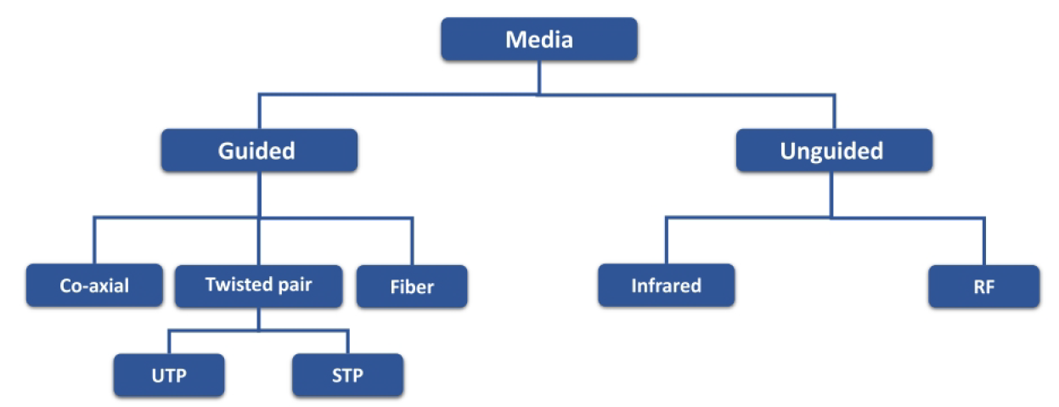
Transmission media

Slide 19
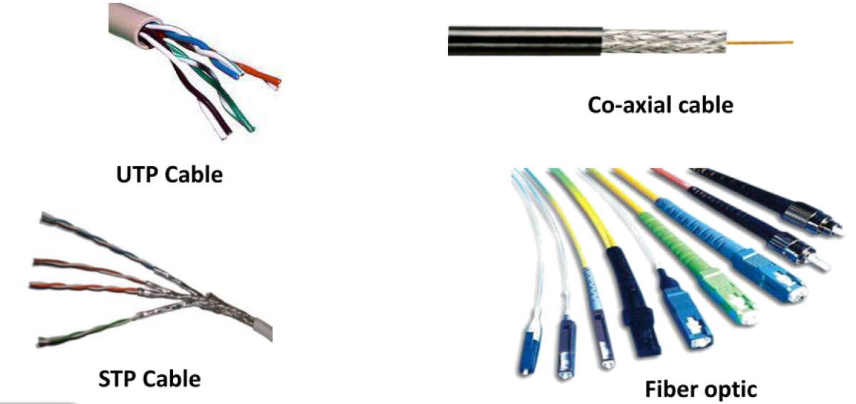
Transmission media

Slide 20
Transmission Media
Transmission medium: Carries information from a source to a destination
Guided media (Wired) include twisted-pair cable (uses electric current), coaxial cable (uses electric current), fiber-optic cable (uses light)
Unguided medium (Wireless) is air

Slide 21
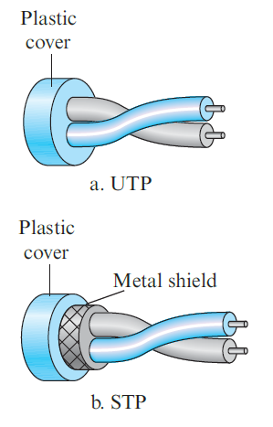
Twisted-pair cable
Consists of two copper wires
Two types
Unshielded twisted-pair (UTP)
Shielded twisted-pair (STP)
Used in telephone networks

Slide 22
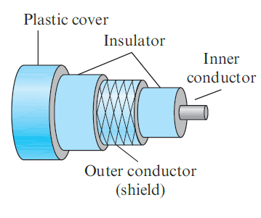
Coaxial cables
Coaxial cable (or coax) carries signals of higher frequency ranges than those in twisted-pair cable
Instead of having two wires, coax has a single copper wire
Usage: Telephone, Cable TV, LAN

Slide 23
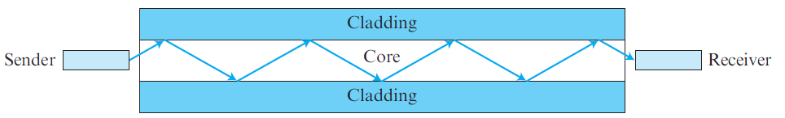
Fiber-optic cable
Made of glass or plastic and transmits signals in the form of light
Modern Ethernet is fiber optic-based

Slide 24
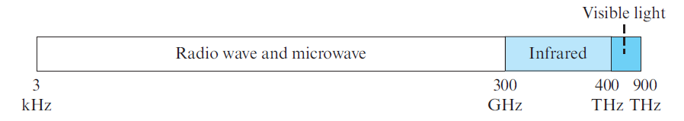
Unguided media
Use electromagnetic waves – no wire is needed
Also called as wireless communication
Signals are normally broadcast through free space and thus are available to anyone who has a device capable of receiving them
The part of the electromagnetic spectrum, ranging from 3 kHz to 900 THz is used for wireless communication.

Slide 25
Ethernet
Most popular LAN technology
Earlier, we also had Token Ring, Token Bus, etc
Ethernet generations
Standard Ethernet (10 Mbps)
Fast Ethernet (100 Mbps)
Gigabit Ethernet (1 Gbps)
10 Gigabit Ethernet (10 Gbps)

Slide 26
Earlier Ethernet – Classic Ethernet
Carrier sense multiple access with collision detection (CSMA/CD) technique was used
Allow any host to send data
If two hosts transmit at the same time, collision happens
They recover using CSMA/CD

Slide 27
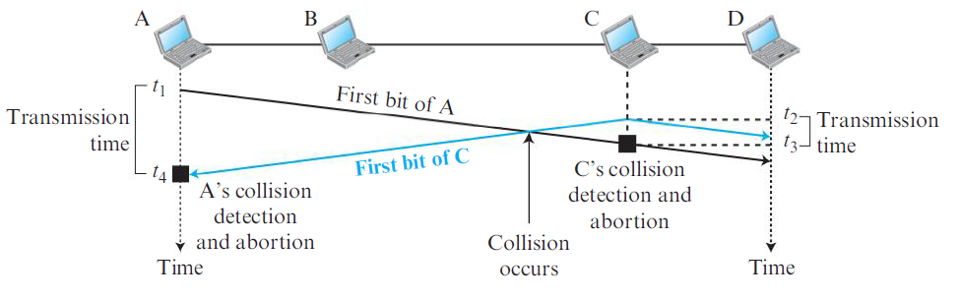
CSMA/CD

Slide 28
Modern Ethernet: Switched Ethernet
Devices called switches are used to connect different computers
Classic Ethernet is the original form and ran at rates from 3 to 10 Mbps
Switched Ethernet
Fast Ethernet: 100 Mbps
Gigabit Ethernet: 1000 Mbps (1 Gbps)
10 Gigabit Ethernet: 10,000 Mbps (10 Gbps)
In practice, only switched Ethernet is used nowadays

Slide 29
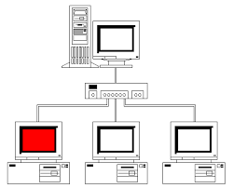
Switched Ethernet
Hosts connect into switches, and switches connect to each other
Ethernet switch

Slide 30
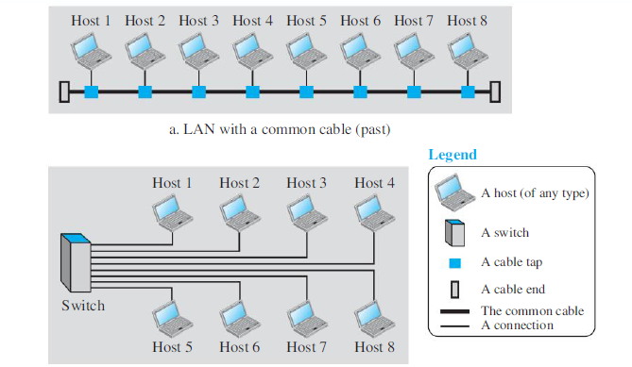
LAN – Earlier and Now

Slide 31
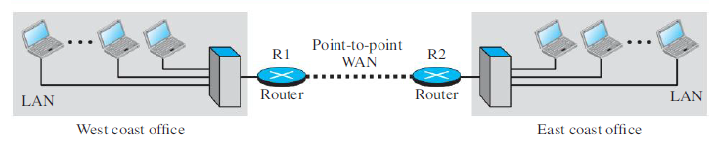
Wide Area Network (WAN)
A Wide Area Network (WAN) spans a large geographical area, often a country or continent
Example: Two LANs can be connected to form a WAN

Slide 32
Sessions 3 and 4

Slide 33
Protocol
Communication between two people or two devices needs to follow some protocol
A protocol is a set of rules that governs communication
For example, in a face-to-face communication between two persons, there is a set of implicit rules in each culture that define how two persons should start the communication, how to continue the communication, and how to end the communication

Slide 34
Network Software
Network software uses a protocol stack
A protocol stack contains many layers or levels
Each layer provides some services to the layer above it
Each layer hides complexity of its work from the layer above it
Creates a protocol hierarchy

Slide 35
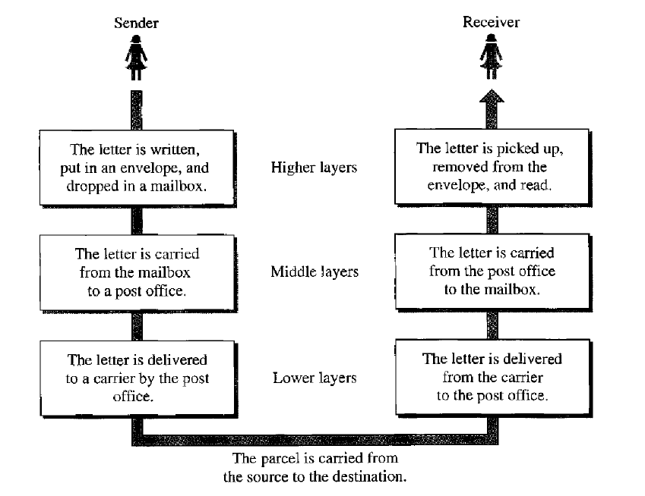
Protocol Hierarchy Example

Slide 36
OSI
Open Systems Interconnection
Good in theory, not used in practice
Contains 7 layers
Sometimes also called ISO/OSI

Slide 37
Layers in OSI
Application Layer
Presentation Layer
Session Layer
Transport Layer
Network Layer
Data Link Layer
Physical Layer
Notes:
37

Slide 38
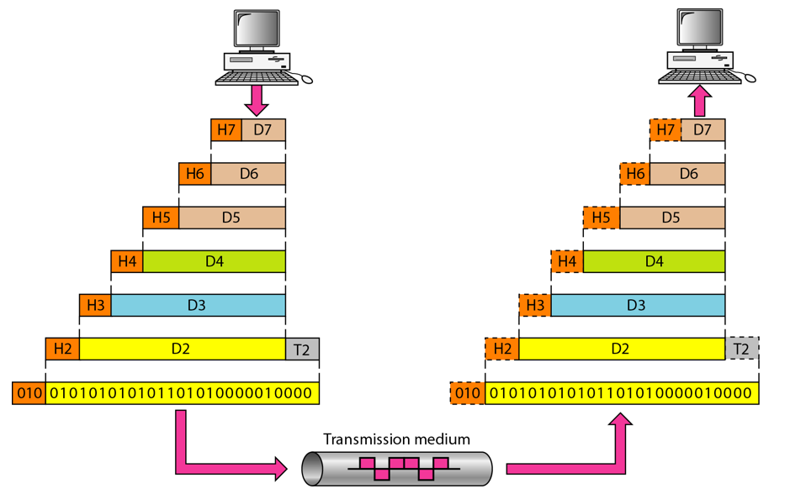
An Exchange using the OSI Model

Slide 39
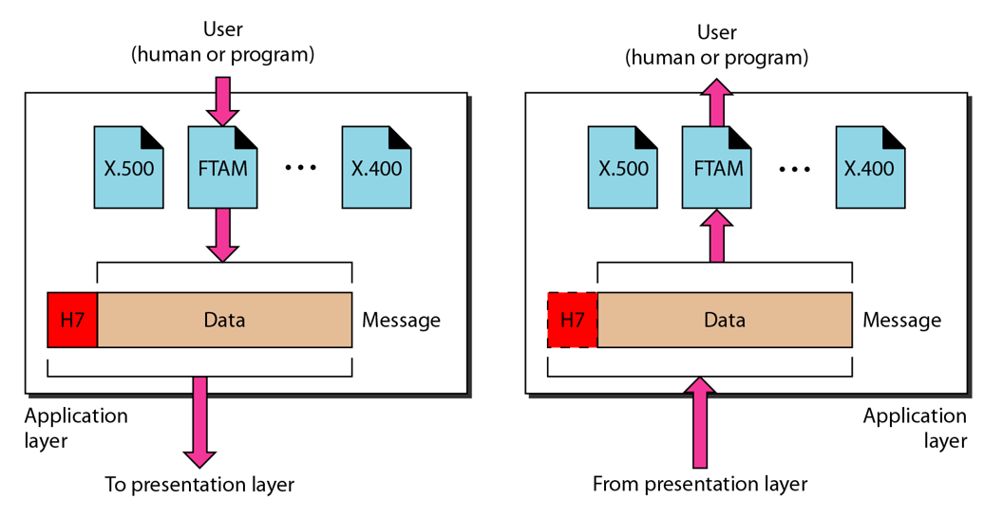
The Application Layer

Slide 40
Application Layer
Provides an “application view” to a network (e.g. email, file transmission)
Example: Hypertext Transfer Protocol (HTTP) is used to access Web pages
Encapsulation begins here
Other examples: Email (SMTP), File transfers (FTP), Querying domain names (DNS)

Slide 41
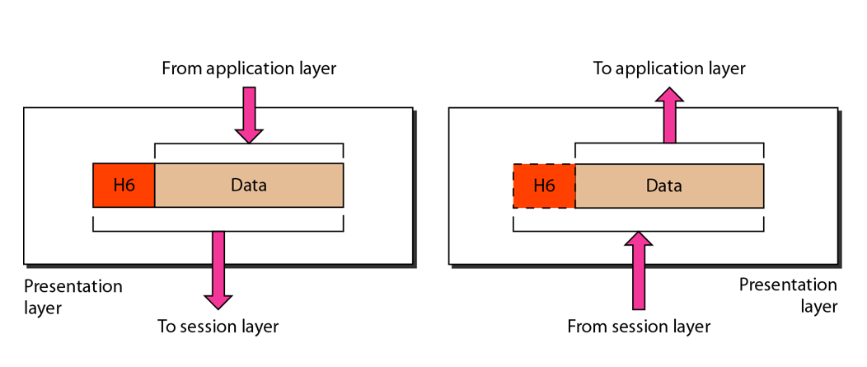
The Presentation Layer

Slide 42
Presentation Layer
Translation: Use of a common format to take care of differences (encoding, number representation etc)
Encryption: To achieve confidentiality or privacy
Compression: Reduces the number of bits needed to be transmitted

Slide 43
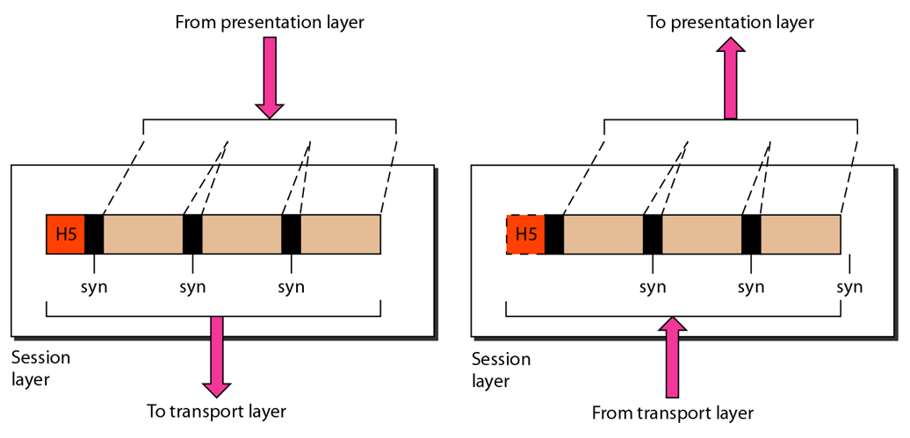
The Session Layer

Slide 44
Session Layer
Manages the session between applications
Example: Between browser of the source computer and server of the destination computer

Slide 45
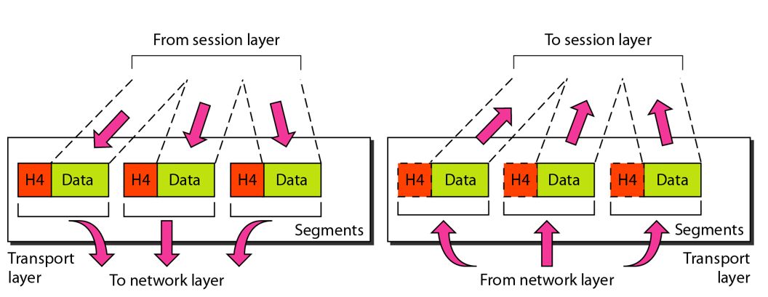
The Transport Layer

Slide 46
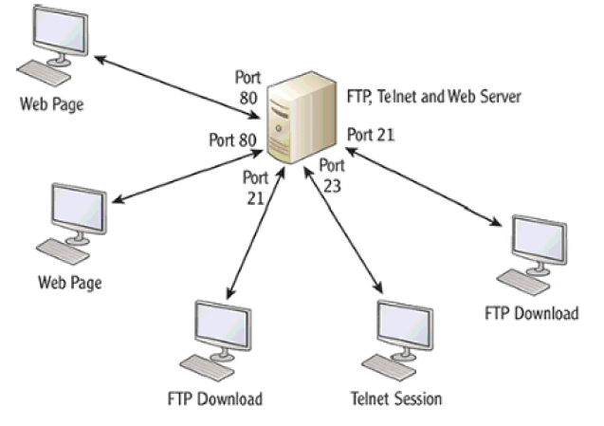
Transport Layer
Identifies the application on the destination computer using port numbers
Example: One server, multiple applications

Slide 47
Port Numbers
Port number is a 16-bit value, so it can store a number between 0 and 65,535
Port Number Range | Where used? | Called as
0-1023 | Server | Well-known ports
1024-49151 | Client | Temporary/Ephemeral
49152-65535 | NA | Dynamic, Usage-based

Slide 48
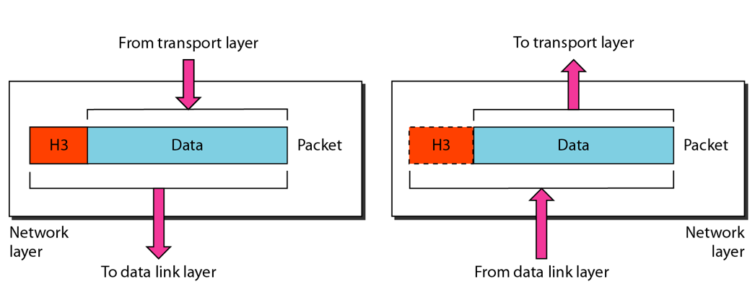
The Network Layer

Slide 49
Network Layer
Physical/MAC addresses are defined by data link layer to take care of addressing inside the same network
If a packet has to travel across a network to another network, physical addressing will not work
Hence, a universal address or a logical address is required. This is done at the network layer
This is the IP address

Slide 50
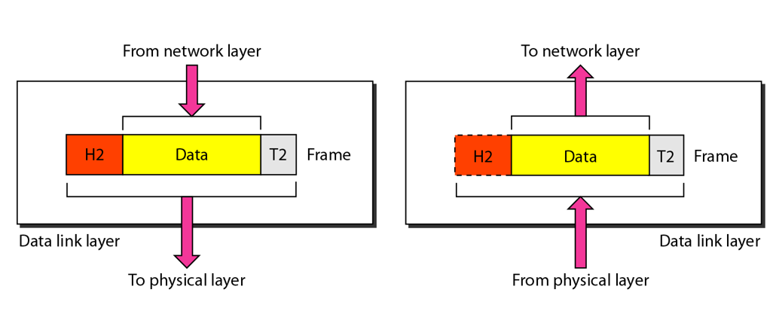
The Data Link Layer

Slide 51
Data Link Layer
Responsible for delivery of packets between two hosts connected to the same physical network (hop-to-hop – see next slide)
Cannot work across networks
Uses frames
Physical addressing: Adding sender’s and receiver’s physical addresses (also called MAC addresses) to the frame header
LAN/WAN operates at this layer (e.g. Ethernet or WiFi)
What if we know the IP address of a computer but do not know its MAC address?
Use Address Resolution Protocol (ARP)

Slide 52
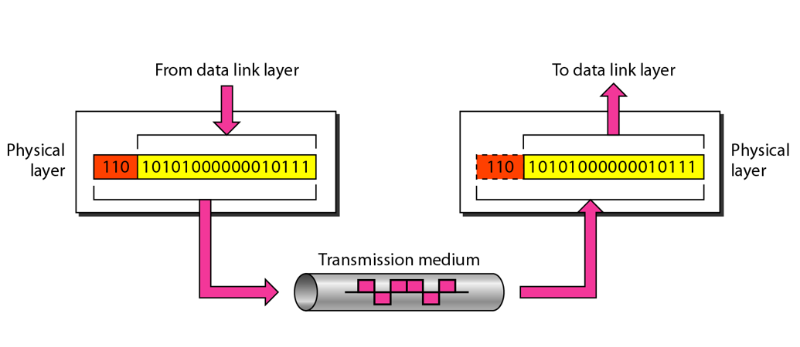
The Physical Layer

Slide 53
Physical Layer Functions
Carries the data (0s and 1s) in the form of signals
Signals can be electric, optical, or wireless

Slide 54
Physical and Logical Address
Each computer on the Internet has two addresses:
Physical address/MAC address/Hardware address
Fixed address, hardcoded on the Network Interface Card (NIC)
Different for different network type (e.g. Ethernet card, WiFi card)
Useful within or inside a network only
Logical address/IP address/Virtual address
Exists in software
Given by the network provider or your organization (usually temporary)
Useful outside a network (e.g. to reach another computer on the Internet, anywhere in the world)

Slide 55
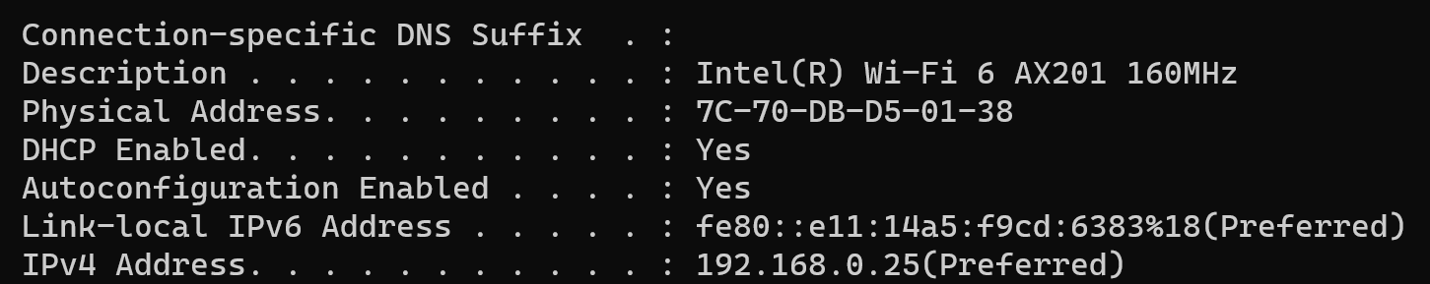
Example

Slide 56
Example
Suppose we have used our web browser to access a web page located on our company’s web server
Consider that the following are the details of the two computers
Computer | IP Address | MAC Address | Port Number
Web server | 192.168.5.1 | 5-5-5-5-5-5 | TCP 80
Laptop | 192.168.5.2 | 6-6-6-6-6-6 | TCP 5091

Slide 57
How will the Web Server Respond?
Layer 7 obtains the data in the form of the HTML document.
Layer 6 adds information about the formatting.
Layer 5 adds information required to create a session between the web server and the web browser on the laptop.
Layer 4 adds the transport protocol and the source and destination port numbers, in this case TCP (it's a unicast) and port 80 (HTTP).
Layer 3 adds the source and destination IP addresses, in this case a source of 192.168.5.1 and a destination of 192.168.5.2.
Layer 2 learns the destination MAC address and adds the source and destination MAC addresses, in this case, a source of 5-5-5-5-5-5 and destination of 6-6-6-6-6-6.
Layer 1 converts the entire package into bits and sends it across the network to the laptop.

Slide 58
How will the Laptop Handle this?
Layer 1 receives the bits in electrical format, converts them to be read by layer 2, and hands them to layer 2.
Layer 2 examines the destination MAC address to see whether it is addressed to it, sees the MAC address of 6-6-6-6-6 (its own), drops that part of the transmission, and hands the remaining data to layer 3.
Layer 3 examines the destination IP address to ensure that it is its own (192. 168.5.2), drops that part, and hands the rest of the package to layer 4.
Layer 4 examines the destination port number (port 5091), alerts the browser that HTTP data is coming in, drops that part, and hands the rest of the package to layer 5.
Layer 5 uses the information that was placed on this layer by the web server to create the session between the web server and the web browser and then hands the rest of the information to layer 6.
Layer 6 performs any format translation that may be required and hands the remaining data (the HTML document) to layer 7.
The layer 7 application (the web browser) receives the HTML document and opens the document in the browser window.

Slide 59
TCP/IP

Slide 60
Basics of TCP/IP
The TCP/IP protocol suite was developed prior to the OSI model
Therefore, the layers in the TCP/IP protocol suite do not match exactly with those in the OSI model
The original TCP/IP protocol suite was defined as four software layers built upon the hardware
Sometimes TCP/IP is thought of as a five-layer model with the layers named similarly to the ones in the OSI model

Slide 61
OSI versus TCP/IP
When we compare the two models, we find that two layers, session and presentation, are missing from the TCP/IP protocol suite
These two layers were not added to the TCP/IP protocol suite after the publication of the OSI model
The application layer in the suite is usually considered to be the combination of three layers in the OSI model
See diagram on the next slide

Slide 62
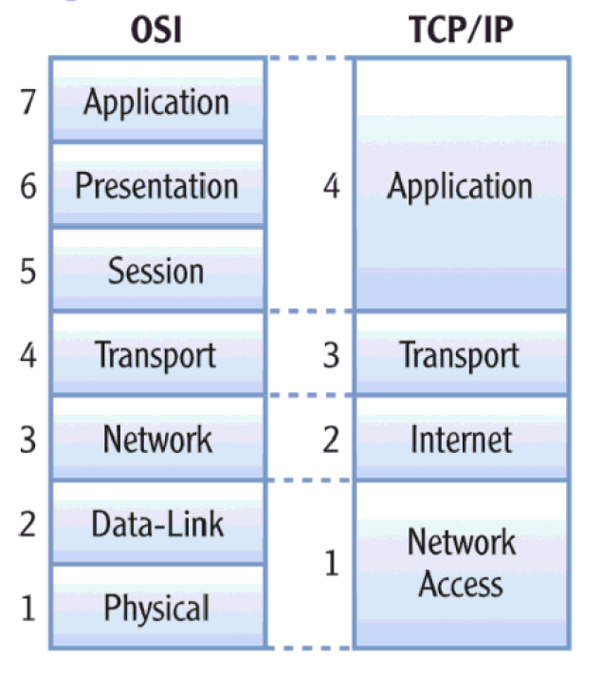
OSI versus TCP/IP

Slide 63
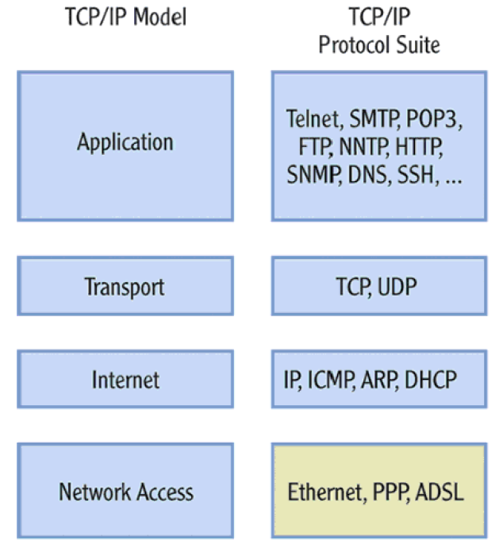
Protocols within Each TCP/IP Layer

Slide 64
Transport Layer Protocols
Transmission Control Protocol (TCP)
Reliable protocol
Guaranteed delivery
Uses connections, acknowledgements
Used for text-based data
User Datagram Protocol (UDP)
Unreliable protocol
No guarantee of delivery
No connections, no acknowledgements
Useful for audio, video or wherever we need speed but not guarantee

Slide 65
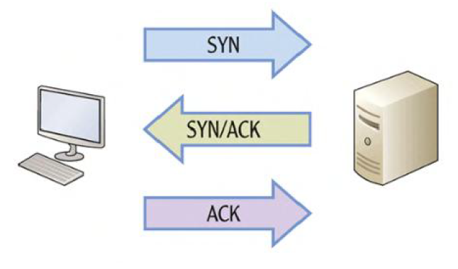
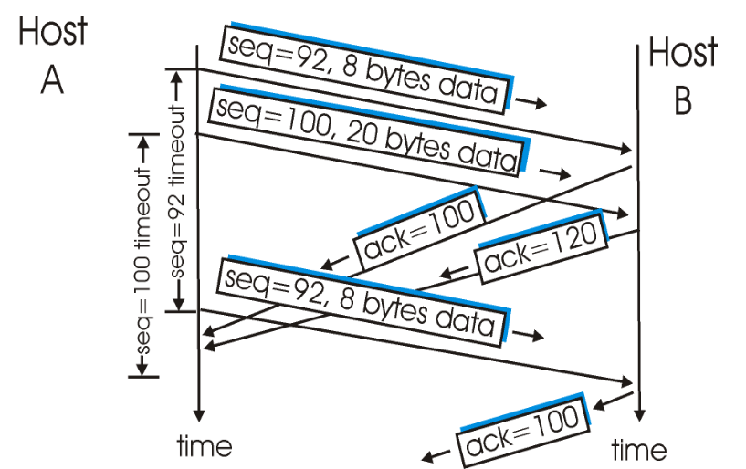
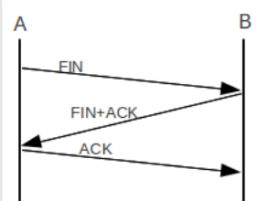
TCP – Connection Management
Connection establishment
Data transfer
Connection termination

Slide 66
UDP
No connection
No acknowledgement
No retransmissions in the case of errors

Slide 67
Internet Layer
Provides logical addressing (IP addresses)
Performs routing
Provides an IP datagram format (See next slide)

Slide 68
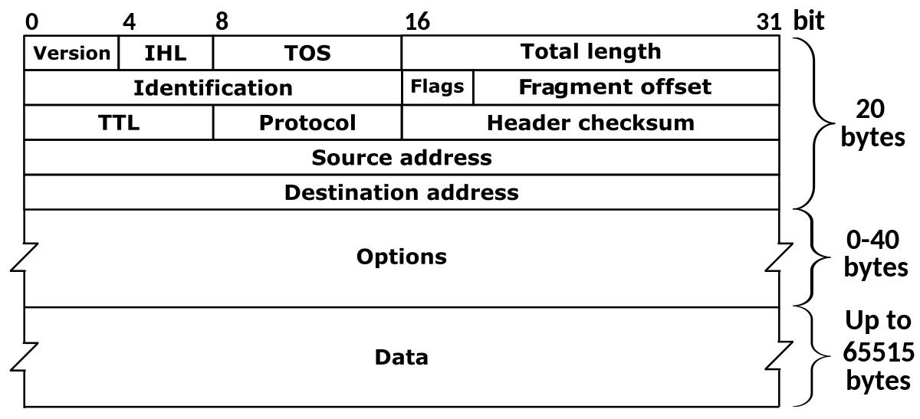
IP Datagram Format

Slide 69
Address Resolution Protocol (ARP)
Takes IP address of a computer as input and finds the MAC address of that computer
Useful to deliver the data to a particular MAC address

Slide 70
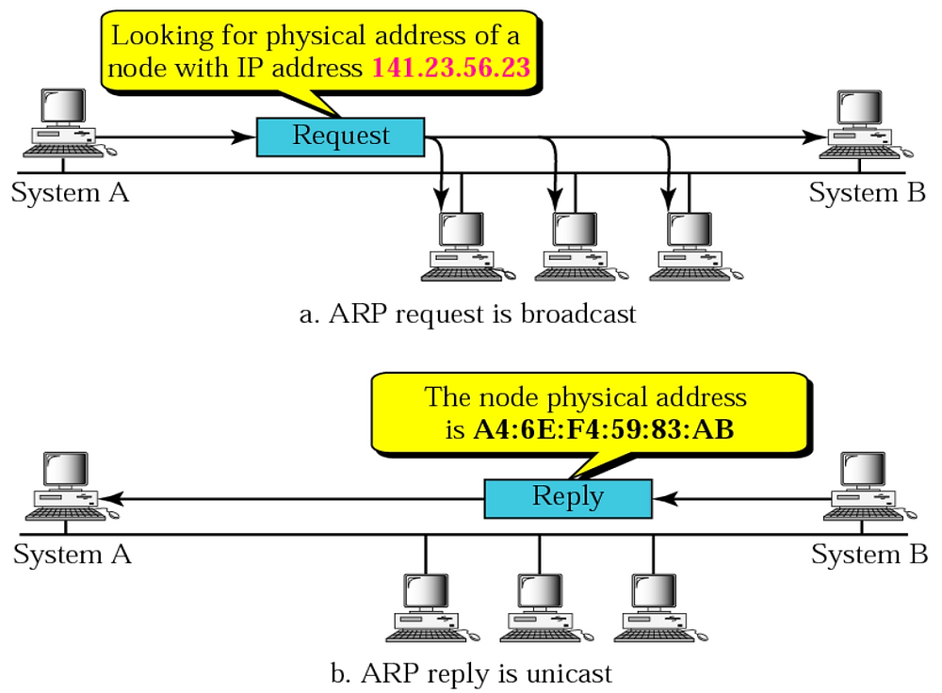
ARP Example

Slide 71
Internet Message Control Protocol (ICMP)
IP is
Connectionless
Unreliable
Unacknowledged
Datagrams are sent over the Internet with no prior connection, no assurance of delivery, and no acknowledgement if they reach the destination successfully
What happens if a router must discard a datagram because it cannot find a router to the final destination, or because the time-to-live field has a zero value?
What happens if the final destination host must discard all fragments of a datagram because it has not received all fragments within a predetermined time limit?
The Internet Control Message Protocol (ICMP) helps IP

Slide 72
ICMP Message Types
Error-reporting messages
Report problems that a router or a host (destination) may encounter when it processes an IP packet
Query messages
Occur in pairs, help a host or a network manager get specific information from a router or another host.
For example, nodes can discover their neighbors.
Also, hosts can discover and learn about routers on their network and routers can help a node redirect its messages.

Slide 73
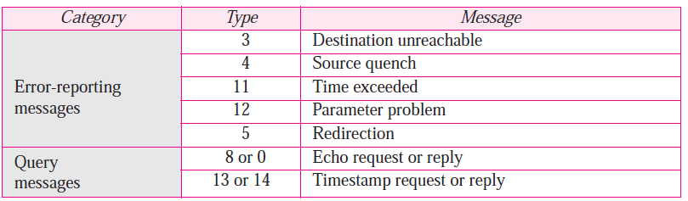
ICMP Messages
Notes:
73

Slide 74
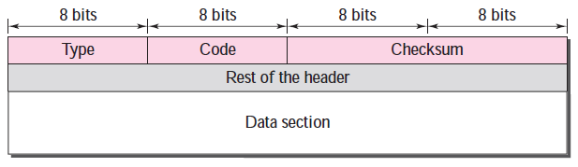
ICMP Message Format
Has a 8-byte header and variable-size data section
General format of the header is different for each message type, the first 4 bytes are common to all
Defines the type of the message
Specifies the reason for the specific message type
Carries information for finding the original packet that had error

Slide 75
Sessions 6 and 7: IP Addressing and Routing

Slide 76
IP Address
An IP address has two parts:
Network Id: Identifies which network it belongs to
Host Id: On a given network, what is the host number
Examples:
This notation is called as dotted decimal notation
Some portion of the network id is reserved to indicate class of IP address
Hence, this is called as classful addressing
14.22.130.89
143.1.99.204
193.56. 78.21

Slide 77
Classes of IP Address
Class A
Class B
Class C
Class D
Class E
Byte 1
Byte 2
Byte 3
Byte 4
0 Network number Host number
1 0 Network number Host number
1 1 0 Network number Host number
1 1 1 0 Multicast address
1 1 1 1 0 Reserved for future use
Notes:
77

Slide 78
IP Addresses Allocation to Classes
Notes:
78

Slide 79
Exercise
How many addresses can each of the classes have?
Notes:
79

Slide 80
Addresses Per Class
Class | Number of Addresses | Percentage
A | 20 Lakh | 50%
B | 10 Lakh | 25%
C | 5 Lakh | 12.5%
D | 2.5 Lakh | 6.25%
E | 2.5 Lakh | 6.25%
Notes:
80

Slide 81
Exercise
Find the class of the following addresses
227.12.14.87
193.14.56.22
14.23.120.8
252.5.15.111
134.11.78.56
Notes:
81

Slide 82
Determining Class Based on an IP Address
Class | Contents of First Byte (Last three are not shown)
A | 1 to 126 (0 and 127 are reserved)
B | 128 to 191
C | 192 to 223
D | 224 to 239
E | 240 to 255
Notes:
82

Slide 83
Determining Class
First bit = 0?
Yes
Class A address
No
Second bit = 0?
Yes
Class B address
No
Third bit = 0?
Yes
Class C address
No
Fourth bit = 0?
Yes
Class D address
No
Class E address
Notes:
83

Slide 84
Masking
Given the IP address of a host, can we find its network address?
“Masking” concept: AND the complete IP address with a “Mask”, result is the network address
Notes:
84

Slide 85
Masking concept
If IP address is 134.45.78.2, network ID is 134.45
An address in the block
AND
Network portion of the IP address
Mask
Notes:
85

Slide 86
Masking Example
If IP address is 134.45.78.2, network ID is 134.45 (See next slide)
134.45.78.2
AND
134.45
255.255.0.0
Notes:
86

Slide 87
Calculation
The address whose network ID we want
134.45.78.2
Default mask for class B (since the address above is from class B)
AND
255.255.0.0
Network ID for the address
134.45.0.0

Slide 88
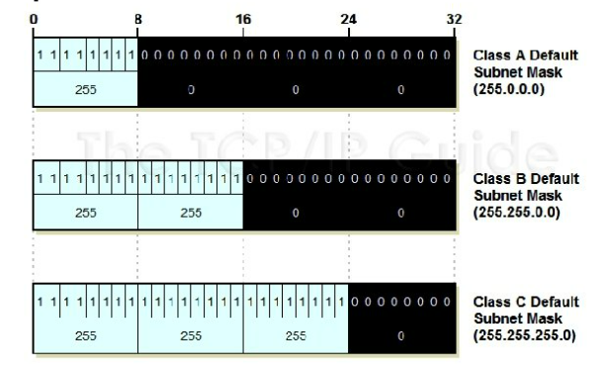
Default Mask

Slide 89
Default Masks
Class | Mask in Binary | Mask in dotted-decimal
A | 11111111 00000000 00000000 00000000 | 255.0.0.0
B | 11111111 11111111 00000000 00000000 | 255.255.0.0
C | 11111111 11111111 11111111 00000000 | 255.255.255.0
Notes:
89

Slide 90
Masking Examples
Given an IP address of 23.56.7.91, find the network address.
Given an IP address of 132.6.17.85, find the network address.
Notes:
90

Slide 91
Private/Local/Internal IP Addresses
The following ranges of IP addresses are reserved as private/local/internal IP addresses, and they cannot be assigned to a computer on the Internet as a public/external IP address
Class A: 10.0.0.0 to 10.255.255.255
Class B: 172.16.0.0 to 172.31.255.255
Class C: 192.168.0.0 to 192.168.255.255

Slide 92
Session 8-10: Network Devices – Hub, Switch, and Router

Slide 93
Networking devices
Inside a network
Hub: Older device
Switch: Modern device
To connect different networks
Router

Slide 94
Hub
Earlier, hubs were used as connection devices in Ethernet
Hub is a dumb device, works only at the physical layer (Layer 1).
So, it does not know about MAC addresses, and hence floods out all the ports.
Hub operates only in half duplex mode
Attached hosts cannot send and receive data at the same time – they can perform only one of the tasks
All devices in a hub share the same collision domain – If two or more devices transmit at the same time, collisions will occur, leading to CSMA/CD

Slide 95
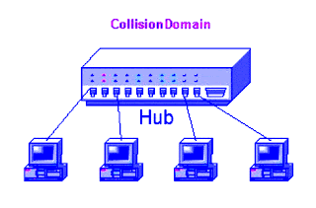
Collision domain concept
All devices that use the same physical media and listen to each frame are considered to be in the same collision domain.
This means that only one device can transmit at any given time, and any other device on the network segment must synchronize with the signal and extract the frame.

Slide 96
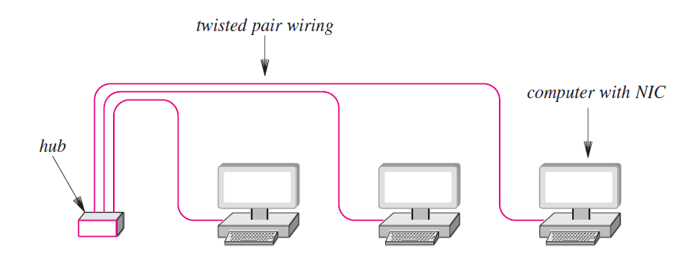
Hub

Slide 97
Switch
Hubs are obsolete
Switch is an intelligent device – can filter traffic
Example
If a hub connects two branches of a network, it will flood both the branches for every received frame
A switch will check whether it should send it to the other branch of the network by comparing addresses, as discussed shortly

Slide 98
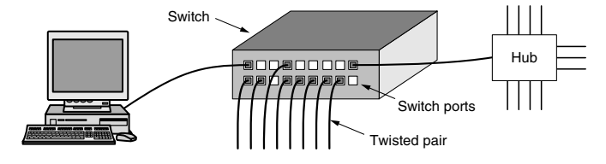
More on Switch
From the outside, a switch looks just like a hub.
They are both boxes, typically with 4 to 48 ports, each with a standard RJ-45 connector for a twisted-pair cable.
If the switch itself fails, it will need to be replaced.

Slide 99
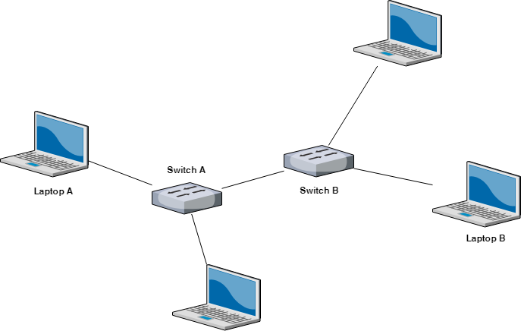
Multiple switches are used these days (Not hubs) …

Slide 100
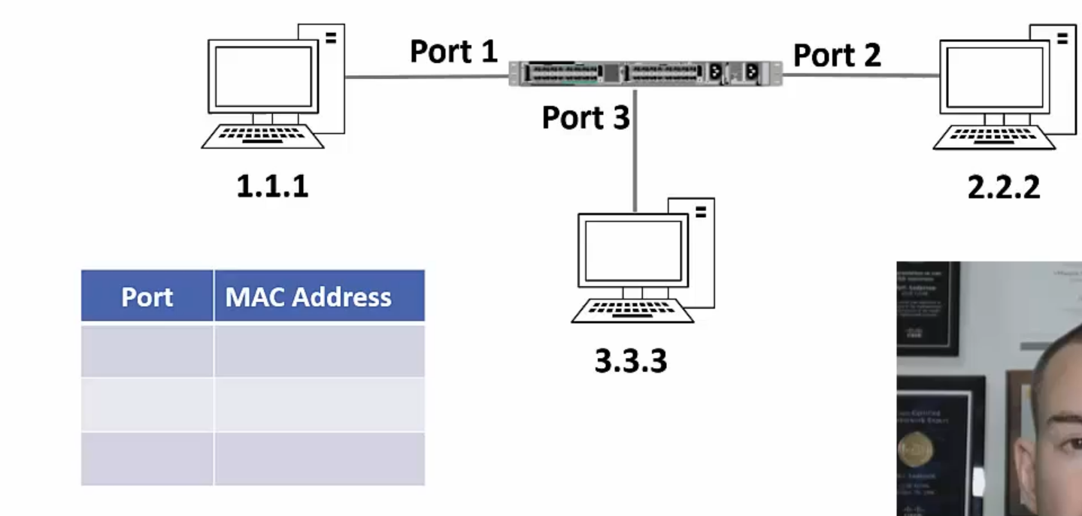
Switching Example – 1
Each switch maintains a mapping table

Slide 101
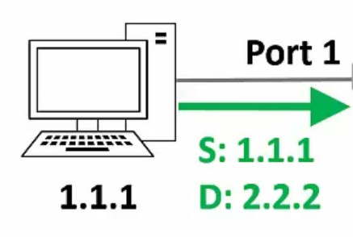
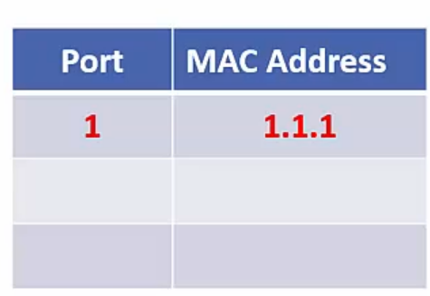

Switching Example – 2
Host 1.1.1 sends a frame to host 2.2.2
Switch sees the frame and updates its mapping table
The switch does not know where 2.2.2 is, so it floods out the frame
`

Slide 102



Switching Example – 3
Suppose host 2.2.2 sends a reply to 1.1.1
Switch sees the frame and updates its mapping table
The switch will send the frame only to 1.1.1

Slide 103

Multi-Switch Example – 1

Slide 104



Multi-Switch Example – 2
Host 1.1.1 sends a frame to host 2.2.2
Switch 1 learns about it and updates the table
Switch 1 floods out the frame

Slide 105



Multi-Switch Example – 3
Switch 2 will also flood out the frame
Switch 2 will add an entry for 1.1.1
Host 2.2.2 sends a response

Slide 106


Multi-Switch Example – 4
Switch 1 updates its table
Switch 1 forwards the frame out from port 1
And like this, the switches will keep learning and updating their tables

Slide 107
“Layer 2” Switch
In OSI, data link layer is layer 2 from the bottom
A switch operates at the data link layer
Hence, sometimes it is also called as Layer 2 switch

Slide 108
Router and Routing

Slide 109


Routing: Key Aspects
Routing table
Routing algorithms

Slide 110
How Routers Learn about Routes?
Default routing
All routes send packets to a single router
Static routing
We manually add routes to the routing tables
Dynamic routing
Routers learn about routes from each other or because of broadcasts

Slide 111

Interior and Exterior Gateway Protocols

Slide 112
Classes of Routing Protocols
Link State Protocols (Example: OSPF)
Form a remote connection with other routers prior to sharing routing data
They don’t broadcast routing data to the whole network
Distance Vector Protocols (Example: RIP)
Use distance to measure the route cost
The number of hops between the router and a destination network establishes the distance
Regularly send their whole routing table to the remote routers
The receiving router then integrates its routing table with the received data based on the metrics
Path Vector Protocols (Example: BGP)
Works across interior networks, i.e. in an exterior network

Slide 113
Routing Information Protocol (RIP)
RIP routers use only routing tables to store information
RIP can store multiple routes to the same destination and uses as its metric a value called hop count
Hop count is the number of routers that are in the path to the destination network using that route
Broadcasts UDP data packets to exchange routing information
Cisco software sends routing information updates every 30 seconds, which is termed advertising
If a device does not receive an update from another device for 180 seconds or more, the receiving device marks the routes served by the non updating device as unusable
If there is still no update after 240 seconds, the device removes all routing table entries for the non updating device

Slide 114
Variations of RIP: IGRP and EIGRP
The Interior Gateway Routing Protocol (IGRP) is a distance-vector routing protocol.
IGRP has been superseded by Enhanced IGRP (EIGRP), which has many new features.
IGRP and EIGRP have a compound metric that takes into account several factors, such as link bandwidth and latency.
As such, IGRP is superior to RIP, which takes into account only the hop count, and RIPv2, which uses both hop count and bandwidth.
In addition to the compound metric, which allows better route selection, IGRP tends to have better convergence times, meaning that routing stabilizes more quickly after a network disruption.
Notes:
114

Slide 115
Drawbacks
IGRP and EIGRP are proprietary protocols, which means they are implemented only by Cisco routers.
IGRP (like RIP) broadcasts the entire routing table, which can consume a lot of network bandwidth
Notes:
115

Slide 116
IGRP versus EIGRP
EIGRP supports VLSM, IGRP does not
Path calculations are improved in EIGRP
EIGRP has less frequent updates as compared to IGRP
Notes:
116

Slide 117
OSPF
Open Shortest Path First (OSPF) is an industry-standard protocol that operates on non-Cisco routers also
Based on link-state routing
Detailed routing information about an area is confined to that area, and only a summary of information is advertised to other areas
This has the benefit of keeping OSPF routing tables smaller
RIP works fine in small networks, but not in large networks
When routers exchange information, it is called as flooding
Frequency of exchange is once in every 1-2 hours

Slide 118
Understanding OSPF
Two aspects: OSPF tables and OSPF packets
OSPF uses three tables
Neighbor Table: Information about neighbors
Topology Table: Information about other routers and networks in the AS
Routing Table
It uses five packets
Hello Packets
Database Descriptor (DBD)
Link State Request (LSR)
Link State Update (LSU)
Link State Acknowledgement (LSAck)

Slide 119

OSPF Neighbor Table
Router R5’s neighbor table

Slide 120

OSPF Topology Table (Link State Database)
Router R5’s topology table

Slide 121

OSPF Routing Table (Link State Database)
Part of Router R5’s routing table

Slide 122
InfiniBand Network

Slide 123
InfiniBand Network
InfiniBand is an open standard network interconnection technology with high bandwidth, low delay and high reliability
This technology is defined by IBTA (InfiniBand Trade Alliance)
This technology is widely used in HPC
Supports basic Single Data Rate (SDR) of 2.5 Gbps
Usually, four cables are used together, to geta speed of 10 Gbps
Another improvement called as Quad Data Rate (QAD) signaling takes this rate to 40 Gbps
Significant advantages over Ethernet and optical fiber

Slide 124
InfiniBand Basics
Traditionally, I/O was handled by the shared PCI bus (32 or 44 bit transfer)
In InfiniBand, the I/O is handled not by processors, but by interconnect architecture
This means that the I/O does not go to the kernel area of the operating system, but directly comes in to or goes out from the user area
Makes it very fast
Packets are of 4 KB

